Slide 1
ASPIRE OVERFLOW
AURORA

Slide 2
Team MEMBERS
Girishkumar R
Gowtham R
Manimaran V
Mohammed Irfan S
Ponvizhi U
Project Duration in Days : 76
Pooja S
Sandhiya S
Sriram M
Venkateshwaran M

Slide 3
ABOUT THIS APPLICATION
Aspire Overflow is developed for the users inside our office.
The main purpose of this platform is to post your queries and to write articles, mostly about technologies.
Normal employee of the company will be the users.
Reviewer is an extra privilege given to the users. Reviewer is the one who reviews the articles.
Admin is another user who has the permission to verify the register user and allow the user to access the website.

Slide 4
EXISTING CHALLENGES
Knowledge sharing will be very limited.
Learnings about the current technologies will not be up-to-date.
Problems and queries takes very much time to resolve.

Slide 5
SOLUTION and ARCHITECTURE
Creation of articles about the thing you want to share.
Posting the queries that you have problem with solving
Answering the queries that you have knowledge of.

Slide 6
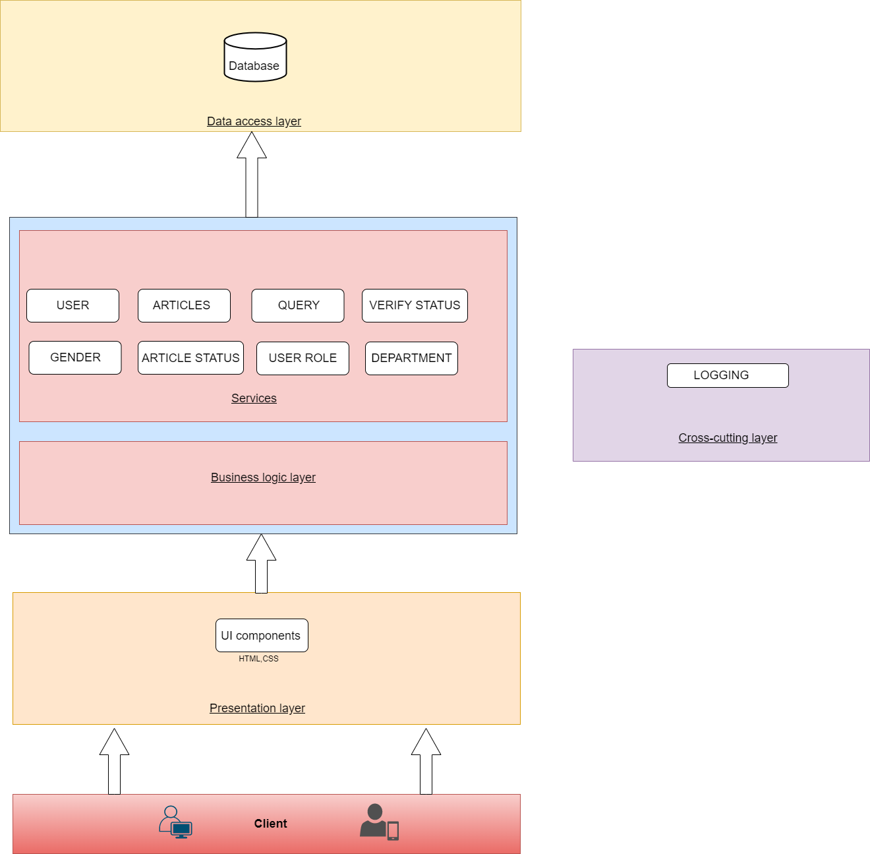

Slide 7
EXECUTION JOURNEY
User stories.
Functional and Non-Functional Requirements.
Wireframe.
HTML Template.
Angular Components.
Web Api.
Integration.
Unit Testing.
Set-up Documentation.
SonarQube.
Linting.
Light House.
Deployment in IIS.
JMeter.
High Level Design.
Low Level Design.
Test Scenarios.

Slide 8
Artifacts
Areas | Link
Requirement – User Stories, Wireframes, Data Flow
Swagger - API | http://172.24.210.43/Aspire-API
Data Model – EAR (Entity Attribute Relationship) | https://github.com/SparkTeamAurora/Project/tree/main/Aurora/Design/Data%20Model
Test Scenarios | https://github.com/SparkTeamAurora/Project/blob/main/Aurora/Documentation/Test%20Scenario.docx
Sequence Diagrams
Defect Logs
Code Quality Metrics | Sonar and Lint reports
Setup Manual

Slide 9
TECHNOLOGIES & Tools USED
Asp Dotnet Core 6.0
Angular 13
Visual Studio Code.
Node js.
Angular.
SonarQube
Jdk
JMeter

Slide 10
DEMO
Web Api - http://172.24.210.43/Aspire-API/swagger
Angular - http://172.24.210.43/AspireOverflow

Slide 11
LESSONS LEARNED
We need to understand the system of the project we are going to do.
Requirement gathering is the first-most thing to be done.
User-Stories should tell about the flow of the system.
Wireframe should reflect the original output.
Set-up documentation should be written simple for the user manual.
Unused and Dead codes should be removed.

Slide 12
THANK YOU
By Team-Aurora

